Slide 1
RNAseq Minicourse
Processing Raw Reads into Counts

Slide 2
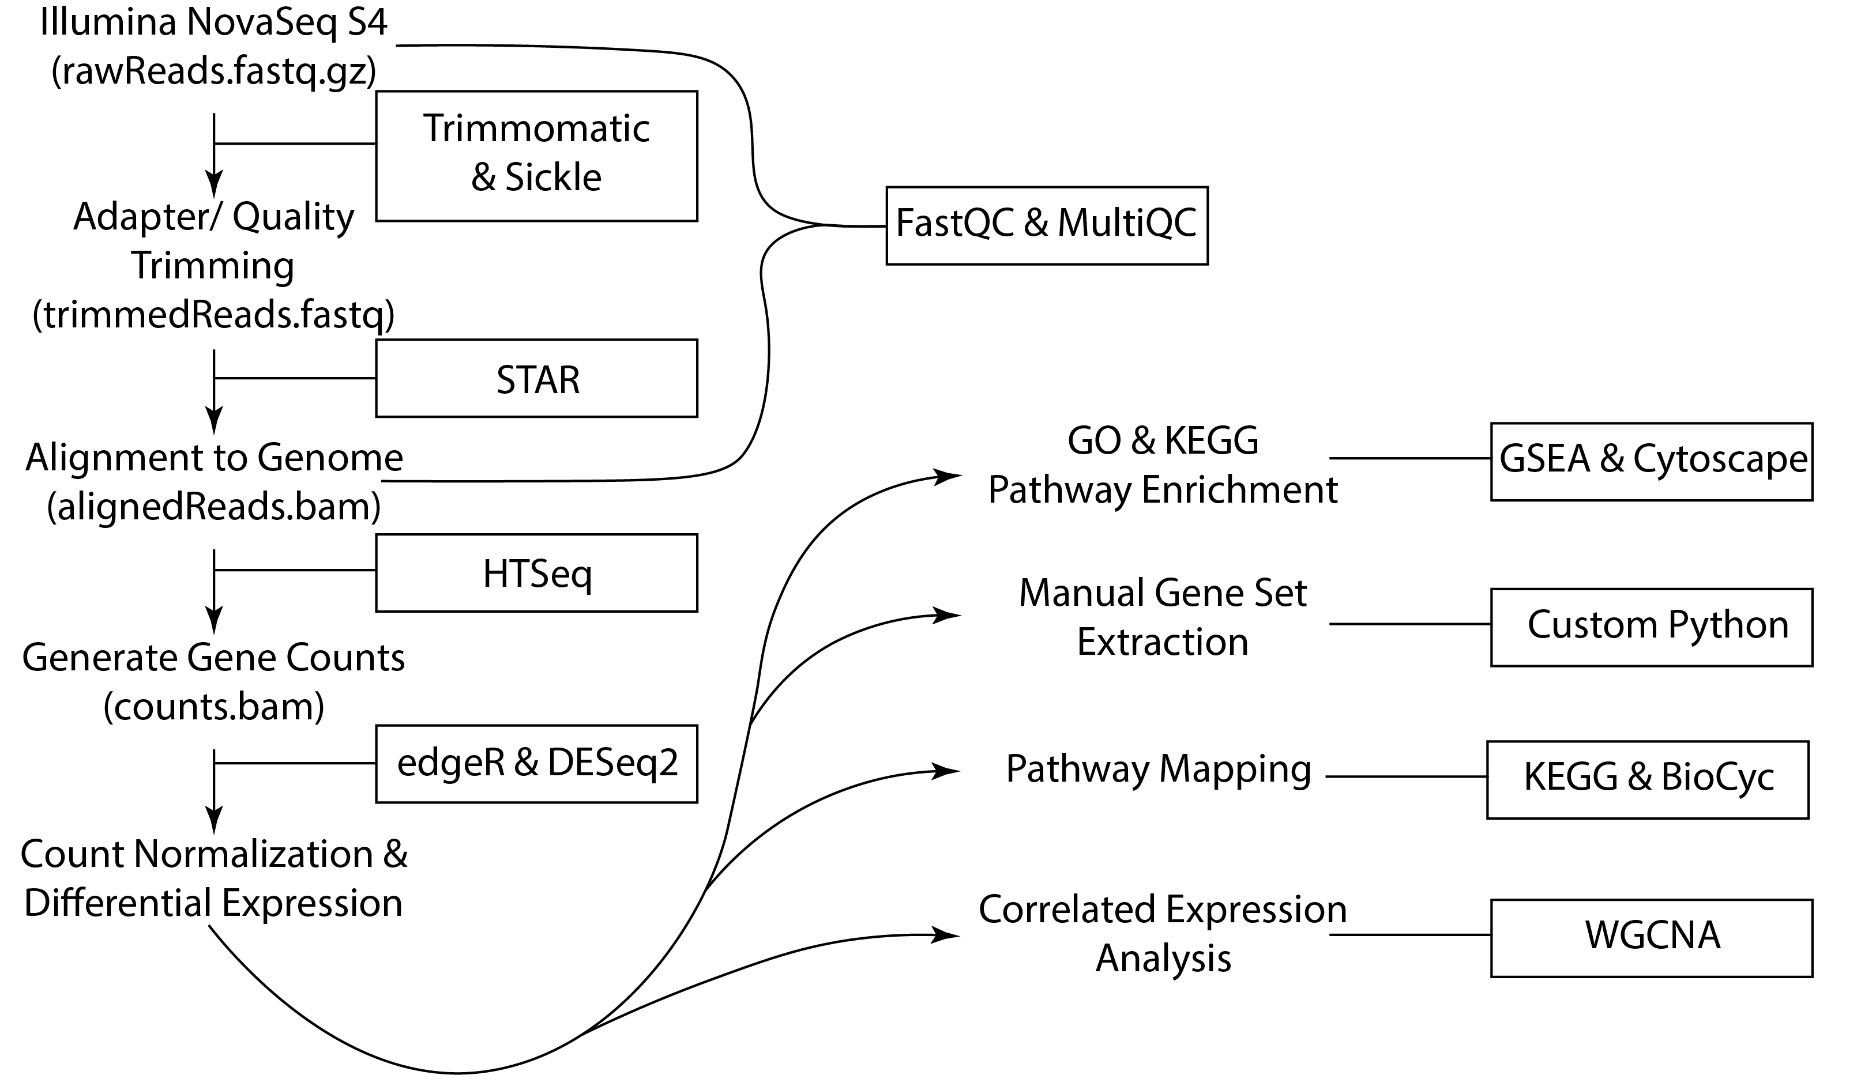

RNAseq Bioinformatic Pipeline

Slide 3
FastQC and MultiQC Explained

Slide 4
Example FastQC Results Viewed in FastQC

Slide 5
Trimmomatic Explained

Slide 6
Trimmomatic Code

Slide 7
Example MultiQC Post Trimmomatic

Slide 8
STAR Explained

Slide 9
STAR Workflow

Slide 10
STAR Code Explained

Slide 11
STAR Output and STAR MultiQC Output

Slide 12
HTSeq Explained

Slide 13
Running HTSeq

